Slide 1


Slide 2

Azure Data Factory, servis za modern obradu podataka u cloudu
Ratomir Vukadin
Belgrade
May 25th, 2019
tweet #tarabica19

Slide 3



Sponzori
Generalni sponzor
Partner konferencije
Srebrni sponzori
Bronzani sponzor
Tehnički sponzori
tweet #tarabica19

Slide 4

Ratomir Vukadin, DevOps Engineer, Klika doo, www.klika.ba
MCT 2019, MCSA for Web Applications, MCSD
MS Network8, Network9, SQLSaturday 2018, WinDays19, Azure Bootcamp 2019, etc.
https://www.linkedin.com/in/ratomir-vukadin-rvs/
https://github.com/Ratomir?tab=repositories
@Ratko_V
Ratomir@live.com / ratomirvukadin@rvsv1.onmicrosoft.com
tweet #tarabica19

Slide 5
#Today’s lecture
Level 300
Azure Portal, Azure SQL Database, Azure Cosmos DB (JSON), HDInisght, Hive code, csv format, Table Storage…
https://github.com/Ratomir/ADFv2WithDataLakeGen2/tree/master
tweet #tarabica19

Slide 6



Agenda
Overview
Overview of Architecture
Preview of…?

Slide 7
Overview of Azure Data Factory

Slide 8





Azure Data Factory
Sources
Data Warehouse
Analysis
Reporting
ETL / ELT

Slide 9
Azure Data Factory
ETL / ELT
Visual UI
Drag and Drop
Code Support
Python, .NET, ARM
Control Flow
Loop, Branch, If
SSIS Execution
Lift and Shift

Slide 10
ETL / ELT

Slide 11

ETL - Extract Transform Load

Slide 12
ETL - Extract Transform Load

Slide 13

ETL - Extract Transform Load

Slide 14
ETL - Extract Transform Load

Slide 15
ETL - Extract Transform Load

Slide 16


ETL - Extract Transform Load

Slide 17
ELT - Extract Load Transform

Slide 18
ELT - Extract Load Transform

Slide 19
ELT - Extract Load Transform

Slide 20
ELT - Extract Load Transform

Slide 21
ELT - Extract Load Transform

Slide 22
ELT - Extract Load Transform

Slide 23

ETL
ELT

Slide 24
Azure Data Factory Concepts

Slide 25





Azure Data Factory Concepts
Pipelines
Activities
Triggers
Linked Services
Datasets
Integration Runtime

Slide 26
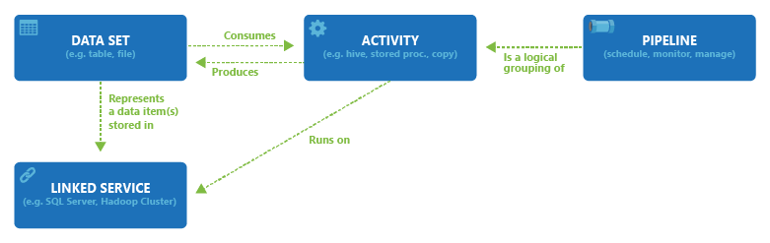

Slide 27
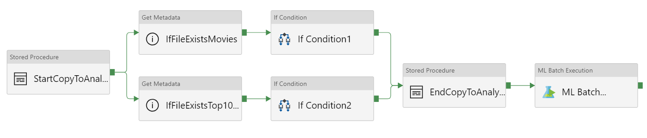
Pipeline, first intro

Slide 28

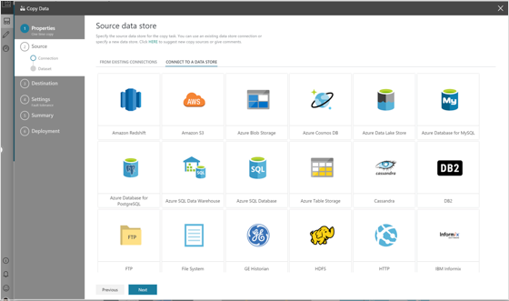
Advantages of Data Factory
Data Engineering Platform
Move data without writing code
Supporting SQL Server Integration Services (SSIS) packages
Multiple different kind of sources/destinations, over 80
Scalable
In cloud/on-premise
HDInsight cluster on-demand
https://docs.microsoft.com/en-us/azure/hdinsight/hdinsight-hadoop-create-linux-clusters-adf

Slide 29
Today’s problem
tweet #tarabica19

Slide 30
#Movies
Movies db set - https://grouplens.org/datasets/movielens/
27,000,000 ratings and 1,100,000 tag applications applied to 58,000 movies by 280,000 users. Includes tag genome data with 14 million relevance scores across 1,100 tags. Last updated 9/2018.
tweet #tarabica19

Slide 31
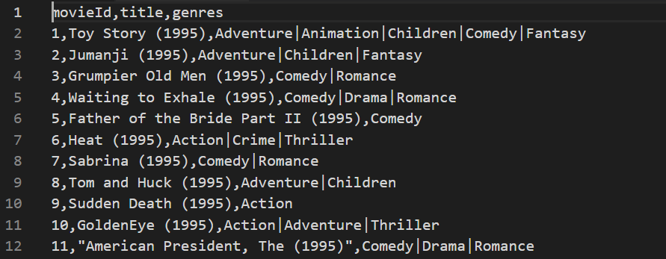
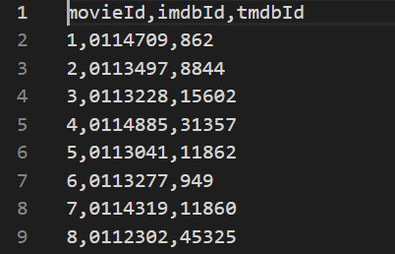
First look of sets

Slide 32
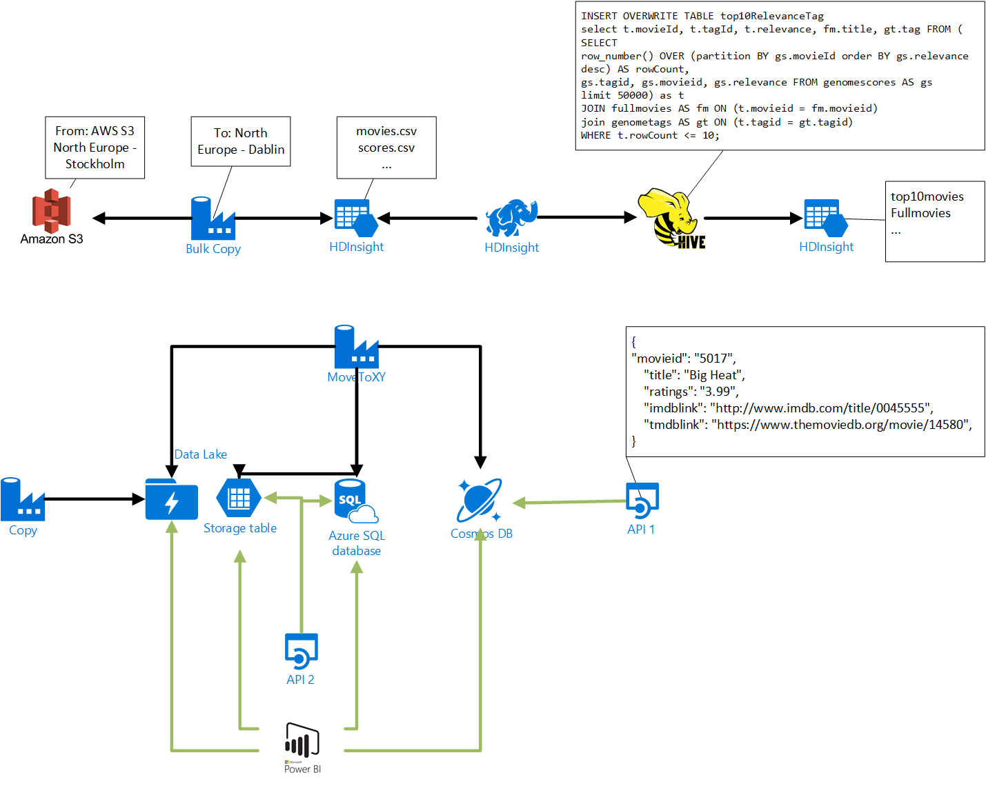

Slide 33
HDInsight and DataLake Gen2
Azure Data Lake Storage Gen2 is the only data lake designed specifically for enterprises to run large scale analytics workloads in the cloud
1
It unifies the core capabilities from the first generation of Azure Data Lake with a Hadoop compatible file system endpoint now directly integrated into Azure Blob Storage
2
Azure Data Lake Storage Gen 2 using popular open source frameworks such as Apache Spark, Hive, MapReduce, Kafka, Storm, and HBase in a secure manner
3

Slide 34
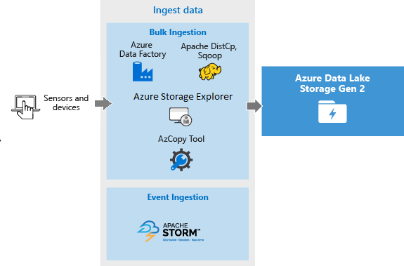
Ingest data

Slide 35
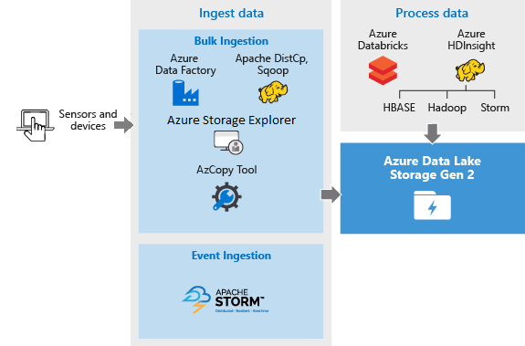
Analyze data

Slide 36
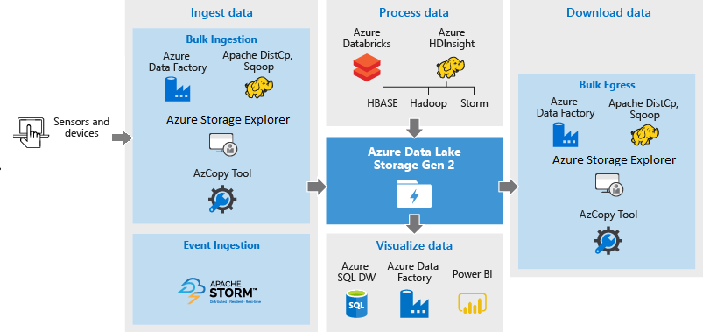
Visualize data

Slide 37
Let’s go on Demo
tweet #tarabica19

Slide 38

Preview of…?

Slide 39

Azure Data Factory Data Flows

Slide 40
Azure Data Factory Data Flows
ETL / ELT
Visual Authoring
Drag and Drop
Azure Databricks
No Code
Transform At Scale
Join, Split, Aggregate, Lookup, Filter, Sort, Derived Column

Slide 41
#Start point
GitHub ADF piplines - https://github.com/Ratomir/ADFv2WithDataLakeGen2/tree/master
Hive scripts – Demo.zip
First example, AdventureWorksLT database – Azure SQL Database
Copy from one table to another with copy activity
tweet #tarabica19

Slide 42

#Quick reference
Data engineering book - https://github.com/andkret/Cookbook
https://docs.microsoft.com/en-us/azure/data-factory/introduction
DataFactory, HDInsight on BlobStorage
https://github.com/Ratomir/ADFv2
Tarabica2019, HDInsight on DataLake Gen2
https://github.com/Ratomir/ADFv2WithDataLakeGen2/tree/master
tweet #tarabica19

Slide 43

Vidimo se / See you soon

